Slide 1
TAXONOMY
The Science of Naming and Classifying Organisms

Slide 2
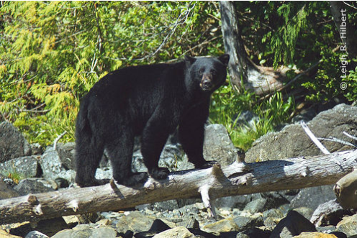
Which one of these is NOT actually a bear?
Photo Credits
Panda: Chi King
Koala: Belgianchocolate
Black Bear: SparkyLeigh
Notes:
Koala is not a bear it’s a pouched mammal.

Slide 3
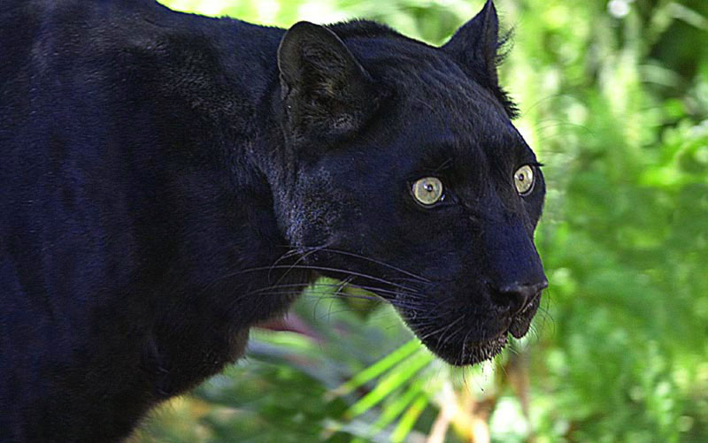
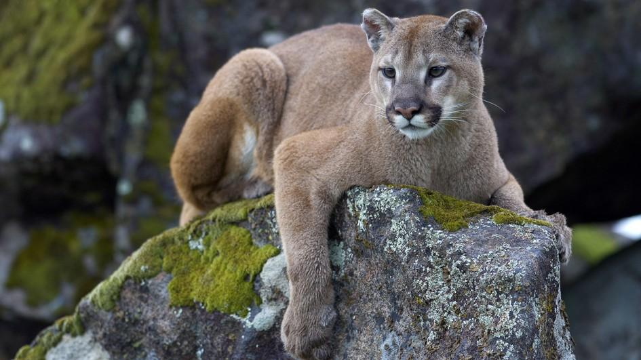
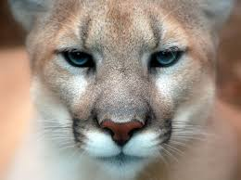
Cougars, Mountain Lions, Pumas and Panthers are all the same cat (Puma concolor).

Slide 4
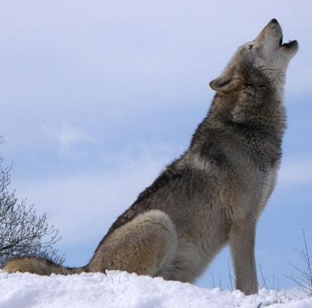
Consider this………..
Are all “Grey Wolves” gray?
Are all “Black Bears” black?
Which is more venomous – a water moccasin or a cottonmouth?

Slide 5
CLASSIFICATION
Carolus Linnaeus
Used Greek and Latin names
Created a system where we place all organisms into a few large groups called kingdoms
Those groups are further divided into smaller groups

Slide 6
Grouping
Kingdom
Phylum
Class
Order
Family
Genus
species
Each group gets smaller and more specific – just think of the way you file things on your computer into folders and subfolders

Slide 7
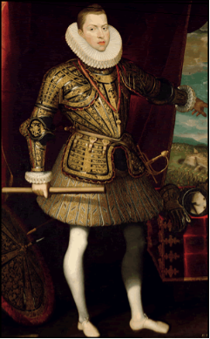
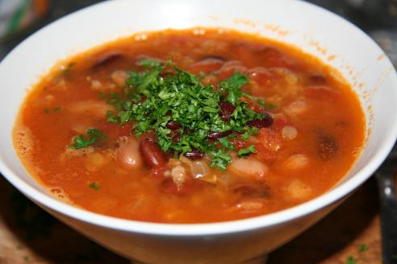
To help you remember the list
KING PHILIP CAME OVER FOR GREAT SOUP
Kingdom, Phylum, Class, Order, Family, Genus, Species

Slide 8
To help you remember the list
KINGS PLAY CHESS ON FINE GRAIN SAND
Kingdom, Phylum, Class, Order, Family, Genus, Species

Slide 9
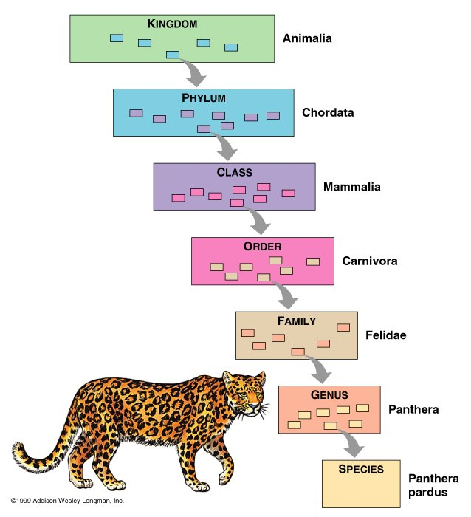

Slide 10
WHICH ARE MORE CLOSELY RELATED?
Kingdom | Animal | Animal | Animal
Phylum | Chordata | Chordata | Chordata
Class | Mammalia | Mammalia | Mammalia
Order | Carnivora | Carnivora | Carnivora
Family | Felidae | Felidae | Canidae
Genus | Panthera | Panthera | Canis
species | leo | pardus | lupus

Slide 11
WHICH ARE MORE CLOSELY RELATED?
Panthera leo & Canis leo
OR
Panthera leo & Panthera pardus

Slide 12
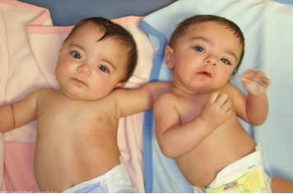
Humans
Kingdom
Animalia
Phylum
Chordata
Class
Mammalia
Order
Primate
Family
Hominidae
Genus
Homo
Species
sapiens
The scientific name is always the genus + species
Humans = Homo sapiens
Photo by atomicshark

Slide 13
Lion
Tiger
Pintail Duck
Kingdom
Animalia
Animalia
Animalia
Phylum
Chordata
Chordata
Chordata
Class
Mammalia
Mammalia
Aves
Order
Carnivora
Carnivora
Anseriformes
Family
Felidae
Felidae
Anatidae
Genus
Panthera
Panthera
Anas
Species
leo
tigris
acouta
What are the scientific names of each of these organisms?

Slide 14
BINOMIAL NOMENCLATURE
The system of naming
Means it is a 2-name system.

Slide 15
More on Naming..
Scientific names must either be underlined or italicized
The genus is always capitalized, the species is lowercase (Ex: Homo sapien)
Can be abbreviated. Ex. F. leo , F. tigris, H. sapien

Slide 16
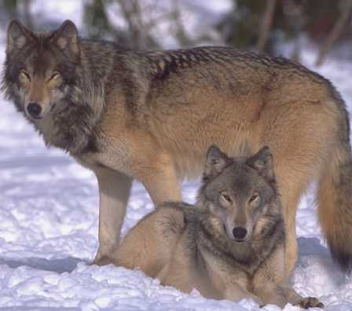
What is a species?
Defined as organisms that can interbreed with one another, and produce fertile offspring

Slide 17
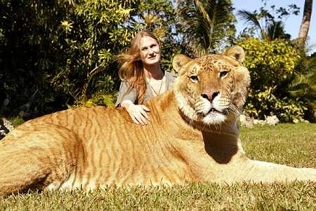
HYBRID
Example: ligers and mules

Slide 18
The Kingdoms
There are currently 6 kingdoms
Classification into a kingdom is based on certain criteria:
How it obtains energy
Number of cells
Type of cell
Movement

Slide 19
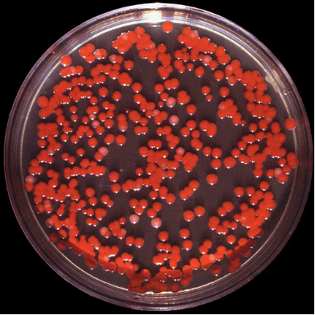
Kingdom Eubacteria & Kingdom Archaebacteria (Monera)
Heterotrophic or autotrophic
# of cells: Unicellular
No: Prokaryotes
Can move: Mobile
Ex:
Eubacteria = common bacteria
Archaebacteria = ancient bacteria, exists in extreme environments

Slide 20
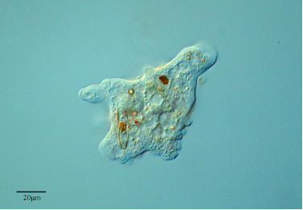
Kingdom Protista/Protist
Heterotrophic or autotrophic
# of cells: unicellular or multicellular
Yes: Eukaryotic
Can move and not move: mobile or sessile
Flagella or cicllia
Examples:
Amoeba
Paramecium
Algae
Most live in Water
Photo of Ameba by PROYECTO AGUA **/** WATER PROJECT

Slide 21
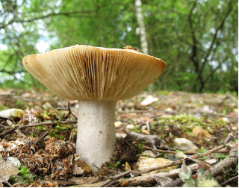
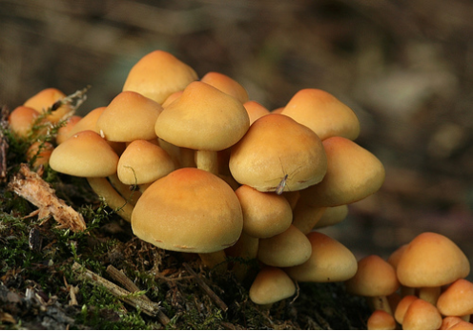
Kingdom Fungi
Heterotrophic
# of cells: Multicellular
Yes: Eukaryotic
Don’t move: Sessile
Have a cell wall
Photos by nutmeg66

Slide 22
Kingdom Plantae/Plants
Producer: Autotrophic
# of cells: Multicellular
Yes: Eukaryotic
Cannot move: Sessile (immobile)
Photo by hira3

Slide 23
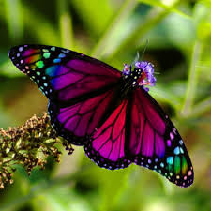
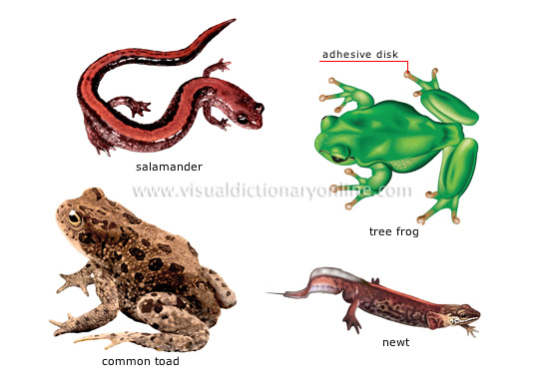
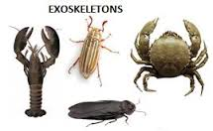
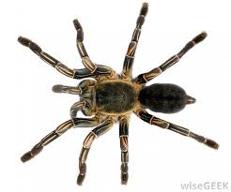
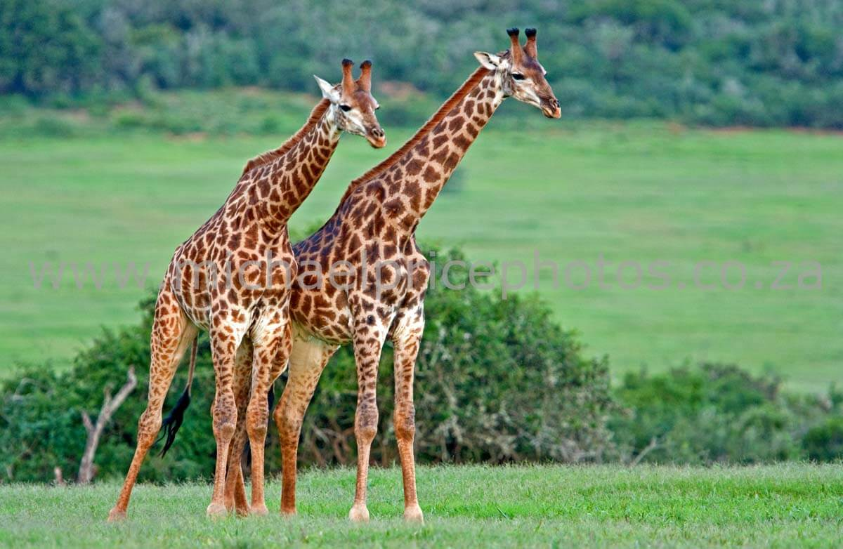
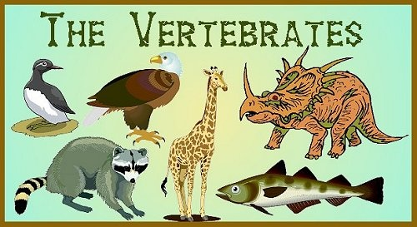
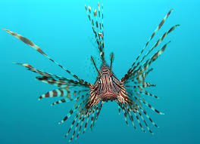
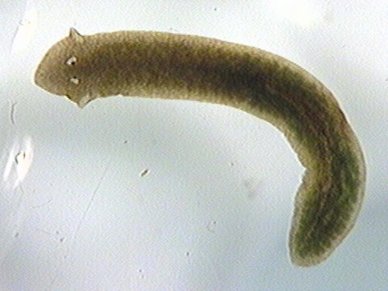
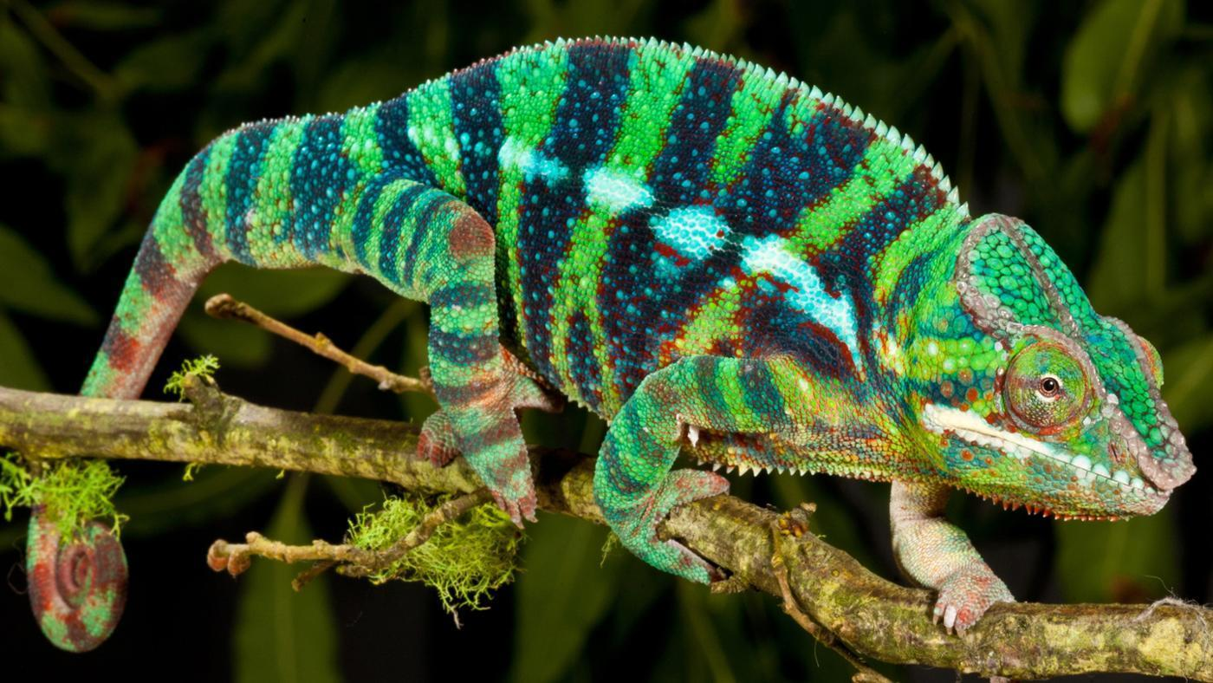
Kingdom Animalia/Animals
Photo by Tambako the Jaguar
Consumer: Heterotropic
# of cells: Multicellular
Yes: Eukakryotic
Can move: Mobile
Photo by Eduardo Amorim

Slide 24
Three Domain System
Domain Eukarya - includes organisms composed of eukaryotic cells (plants, animals, fungi, protists)
Domain Bacteria - includes all prokaryotic cells, Kingdom Eubacteria
Domain Archaea - includes only "ancient" bacteria, Archaebacteria

