Slide 1
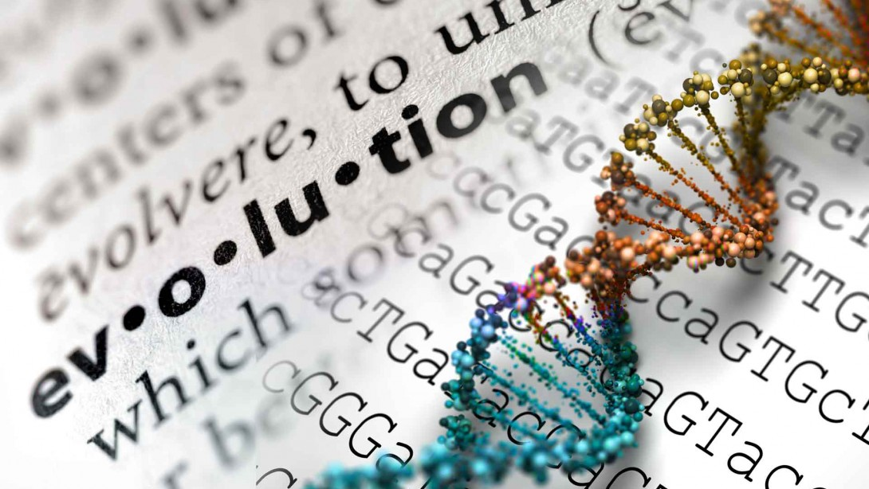
EVOLUTION
Change over time

Slide 2
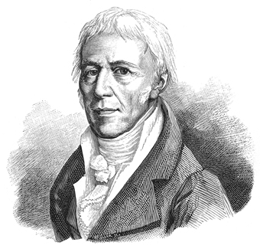
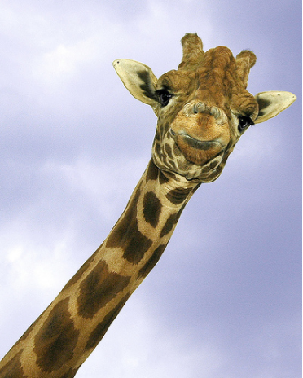
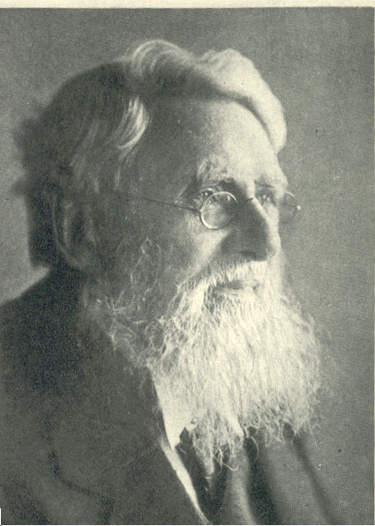
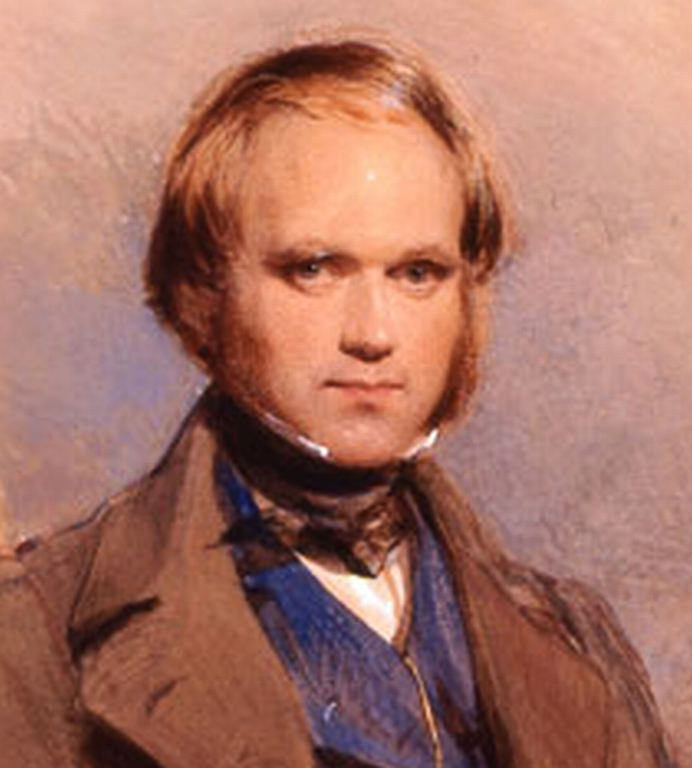
Scientists who studied change
Jean Lamarck – acquired characteristics
Alfred Wallace
Charles Darwin
Charles Lyell
  Geologist
Thomas Malthus
  Studied Human populations

Slide 3
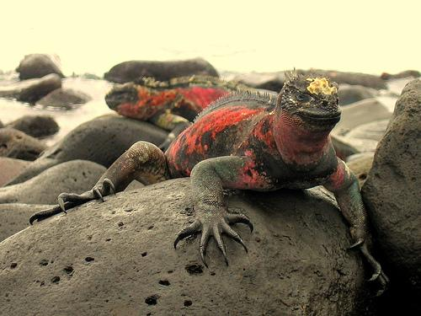
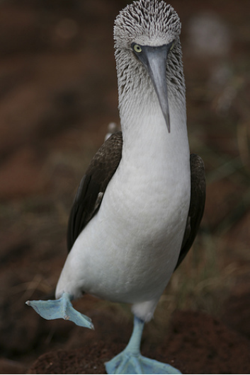
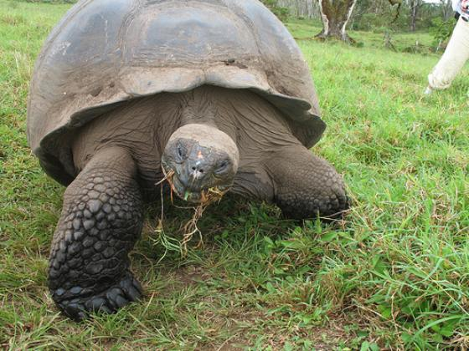
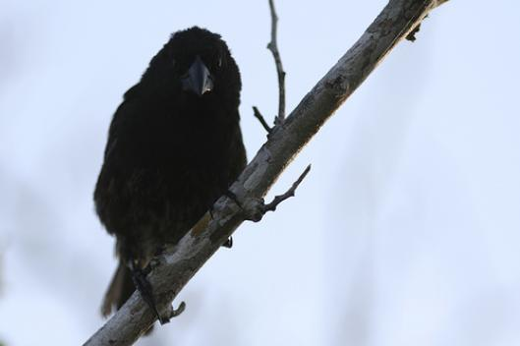
Marine Iguana
Giant tortoise
Blue-footed booby
Finch

Slide 4
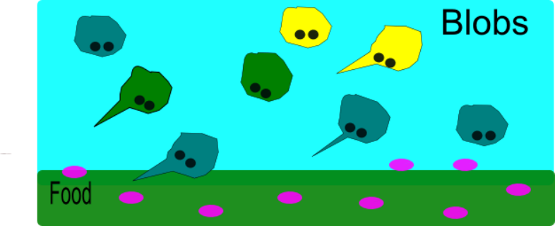

Slide 5
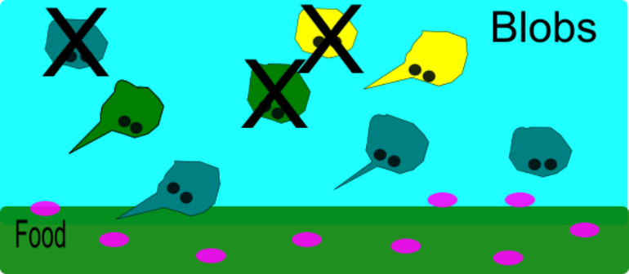

Slide 6
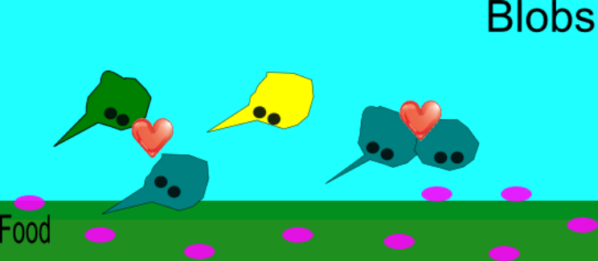

Slide 7
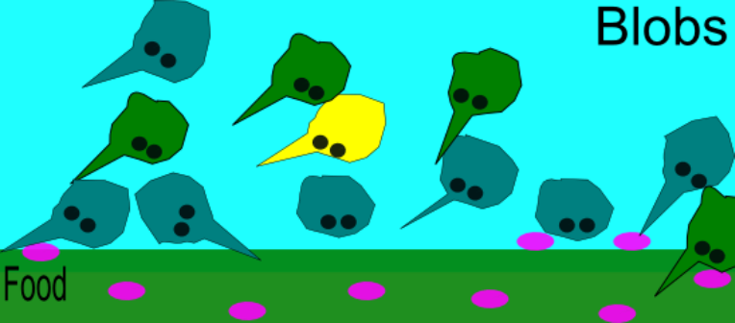

Slide 8
1. Many variations exists among individuals in a species
2. Individuals will compete for resources
3. Competition would lead to the death of some individuals while others would survive
4. Individuals that had advantageous variations are more likely to survive and reproduce

Slide 9
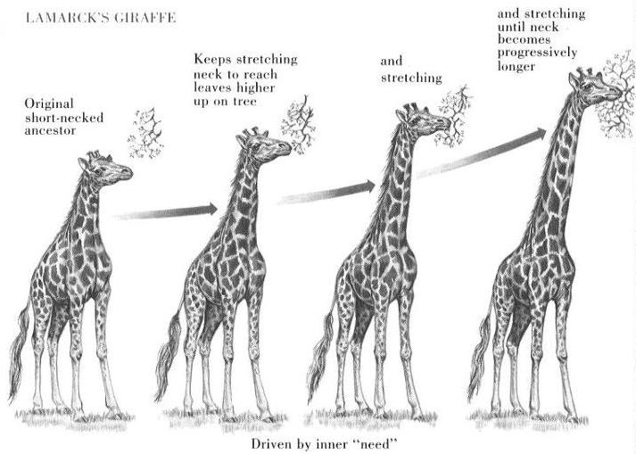
This process came to be known as NATURAL SELECTION
The favorable variations are ADAPTATIONS
Fitness: an organisms ability to survive and produce fertile offspring

Slide 10
Evidence
1. Fossil record
2. Comparative anatomy
3. Embryological development
4. Comparative DNA
5. Biogeography

Slide 11
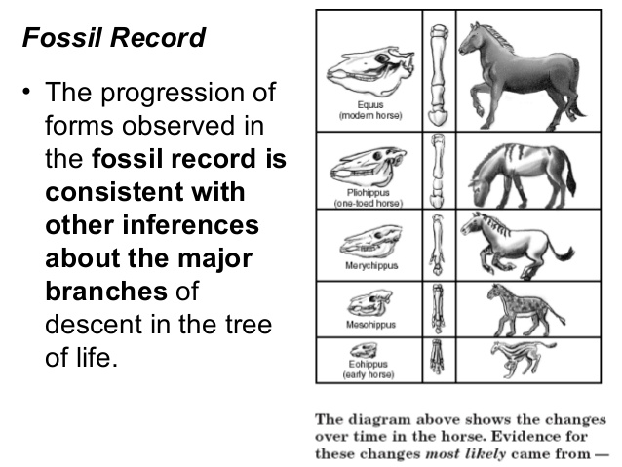
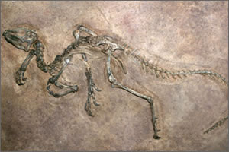
Fossil Evidence
  All organisms living today share common ancestry with earlier simpler life forms

Slide 12
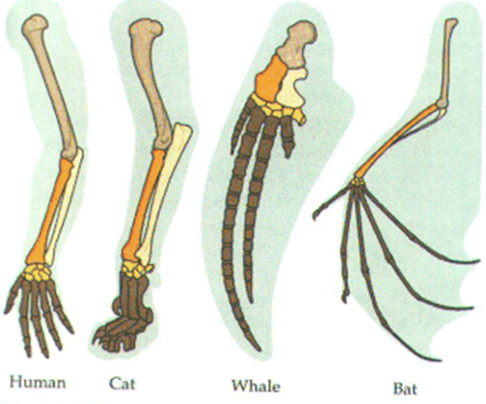
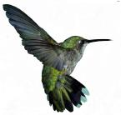
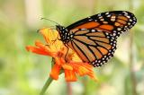
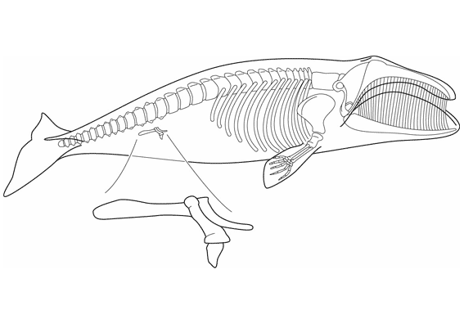
Comparative Anatomy
1. Homologous Structures
  Structures that share a common ancestry
  Same structure; Different function
2. Analogous Structure
  Features that don’t derive from a common ancestor
  Same Function: Different Structure
3. Vestigial Structure
  Structures that are considered evidence of an organism's evolutionary past
  Not used anymore

Slide 13
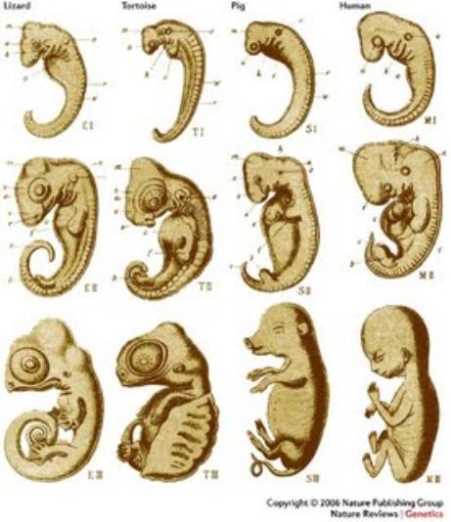
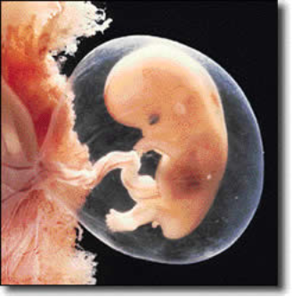
Embryological Development
Embryos of different species develop in almost identical ways.
Human fetus at 8 weeks

Slide 14
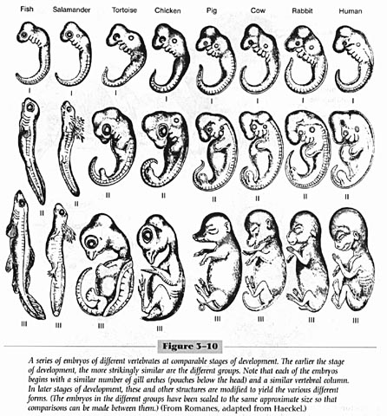

Slide 17
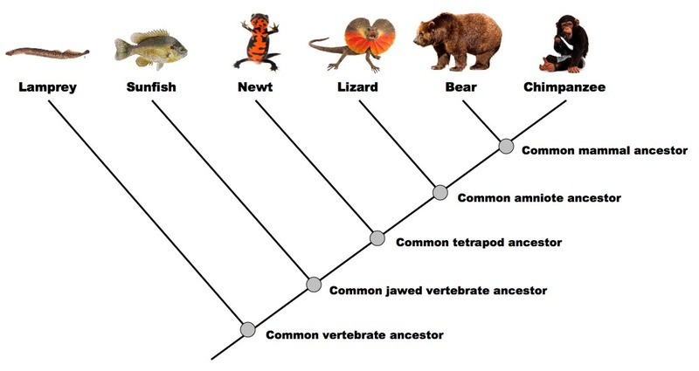
Comparing DNA
  Scientists look at similar DNA sequences of different animals to see how closely related animals are to make cladograms.

Slide 18
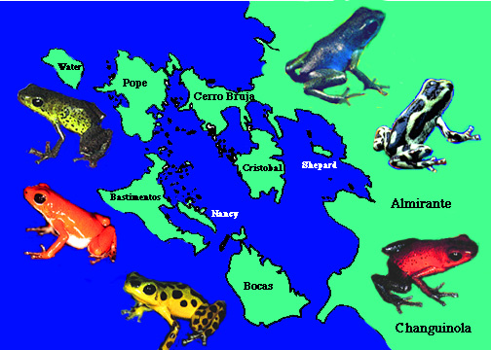
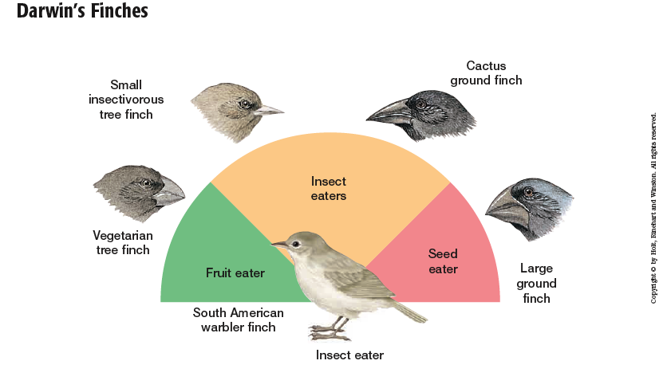
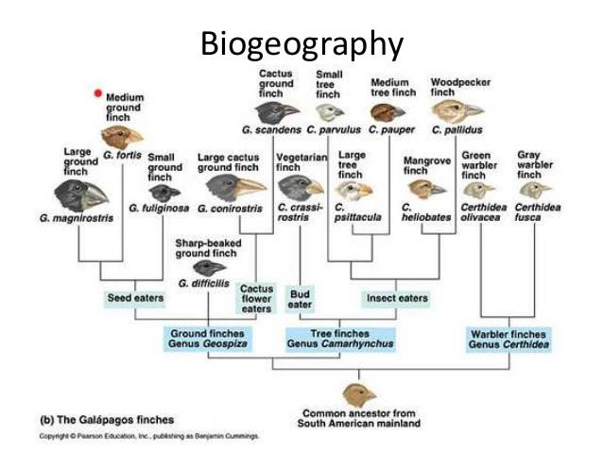
Biogeography
  How and why plants and animals live where they do

Slide 19
How evolution happens
Microevolution
  Occurs over a relatively short period of time within a population or species. Mutation, selection, gene flow, and genetic drift.
Macroevolution
  Occurs over geologic time
  Result of microevolution over time, like speciation

Slide 20
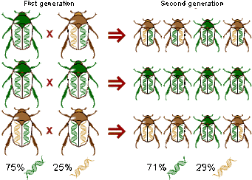
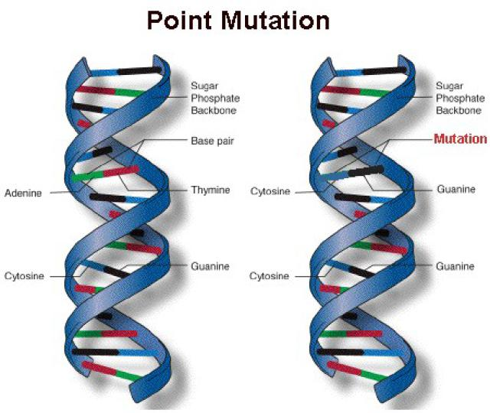
Allele Frequency
  How often an allele occurs in a gene pool relative to the other alleles for that gene
  Mutations
    How new alleles first arise

Slide 21
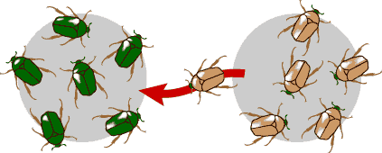
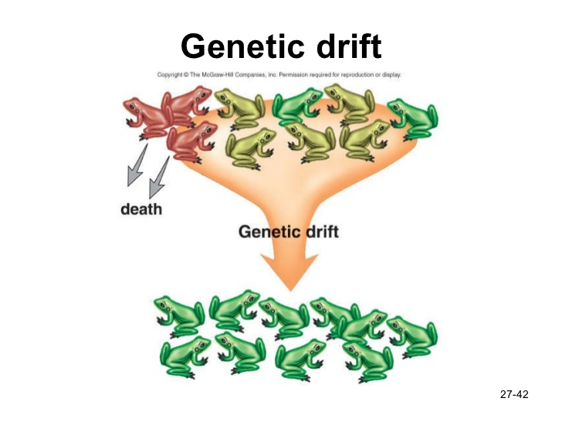
    Gene flow
      Occurs when individuals move into or out of a population.
      Genetic Drift
      random change in allele frequencies that occurs in a small population

Slide 22
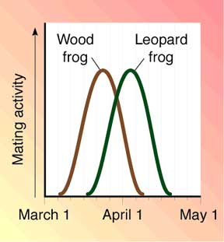
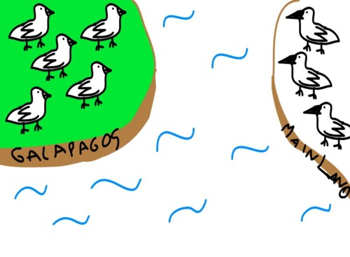
Reproduction Isolation
Sympatric Speciation
The condition in which two populations of the same species do not bred with one another because of geographic separation, a difference in mating periods, or other barriers

