Slide 1
Introns, Exons and Mutations

Slide 2
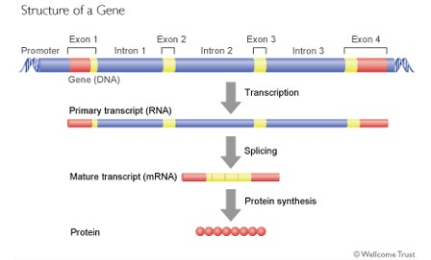
Introns
Long segments of nucleotides that have no coding information

Slide 3
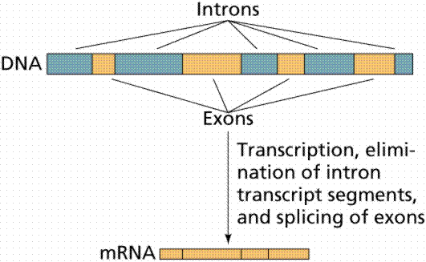
Exons
Are the portions of a gene that are translated (expressed) into proteins.

Slide 4
How is works
After transcription, introns are cut out by spliceosomes.
The exons are stitched back together by the spliceosomes.
The exons make a smaller mRNA molecule that is then translated.

Slide 5
Mutations
The changing of the structure of a gene.
Gametes mutation are passed to offspring of the affected individual, but mutations in body cells affect only the individual in which they occur.

Slide 6
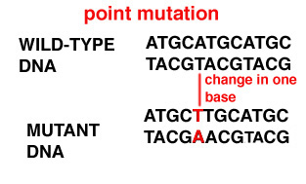
Point Mutation
A single nucleotide changes.

Slide 7
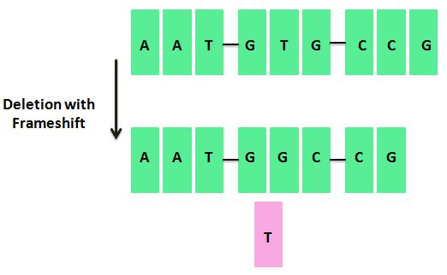
Deletion Mutation
Segments of a gene are lost, often during meiosis.

Slide 8
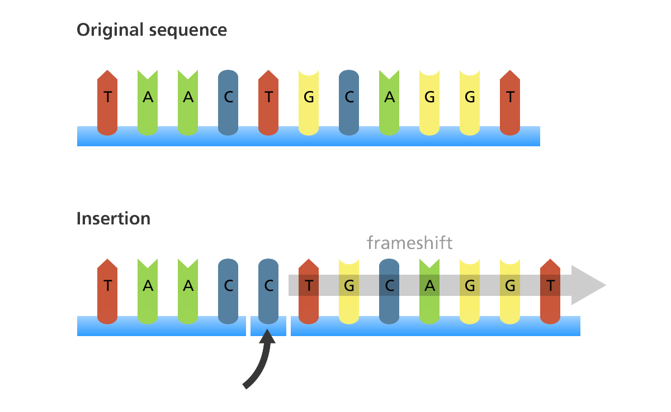
Insertion Mutation
A sizable length of DNA is inserted into a gene.

Slide 9
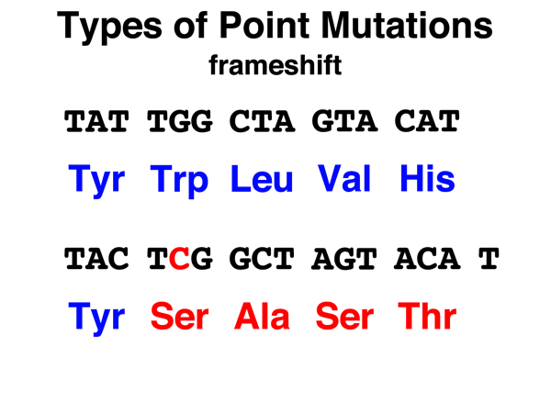
Frameshift
A mutation that causes a gene to be read in the wrong three-nucleotide sequence

